Slide 1

Student Name
MCA IV Semester Project II Review Presentation
: P.V.Dharani
Roll No
Project Title
: 23BFF00097
: Machine Learning based Spam Comments Detection on YouTube
Guide Name
: Mr.M.Vasu MCA.,
Assistant Professor.

Slide 2
Contents
ABSTRACT
INTRODUCTION
PROBLEM STATEMENT
EXISTING SYSTEM
PROPOSED SYSTEM
SOFTWARE REQUIREMENTS
HARDWARE REQUIREMENTS
MODULES
UML DIAGRAMS
SYSTEM TESTING
SCREEN SHOTS
CONCLUSION
REFERENCES

Slide 3
ABSTRACT
The rise of spam comments on YouTube affect user interaction and poses security risk, machine learning(ML) offers a solution by automating spam detection.
ML algorithms leverage their capacity to analyze extensive data and patterns, enabling them to effectively differentiate between authentic comments and spam.
An established technique in ML for detecting spam comments is the Naive Bayes classification algorithm.
By leveraging natural language processing (NLP) techniques, we analyze comment patterns and extract relevant features to classify comments as spam or legitimate

Slide 4
INTRODUCTION
So, by using the concept called machine learning we can predict and detect the spam.
The algorithm that have been used for detecting is Naive Bayes algorithm which predicts which comments are spam and which not and various algorithm have been used.
For spam comment detection but however Naive Bayes is best suitable as it is faster compared to other algorithms and perform better probabilistic calculations.

Slide 5
PROBLEM STATEMENT
The problem statement of Machine Learning-based spam comments detection on YouTube is to develop a predictive model that can classify YouTube comments as either spam or not spam.
The model will analyze the content and characteristics of comments, utilizing ML algorithms, to automatically identify and filter out spam comments.
The objective is to create a robust and efficient system that enhances user experience, safeguards user privacy, and reduces the volume of spam comments on the platform.

Slide 6
EXISTING SYSTEM
Researchers have applied various ML techniques for spam detection.
Popular approaches include Support Vector Machines (SVM), k-Nearest Neighbors (k-NN), and Neural Networks.
These methods assess the probability of a comment being spam based on its attributes and spam-related keywords.
The algorithm's simplicity and efficiency make it a popular choice for classifying comments and distinguishing between spam and non-spam with satisfactory accuracy.

Slide 7
DISADVANTAGES:
vg
Independence Assumption :Naive Bayes assumes words in a comment are independent, reducing accuracy.
Handling New Words :Struggles with unseen words, leading to misclassification. Naive Bayes relies on the occurrence of specific words or phrases in the training data.
Feature Sensitivity :The performance of Naive Bayes heavily depends on the choice and quality of features used for classification.

Slide 8
PROPOSED SYSTEM
The proposed system aims to enhance the accuracy of spam comment detection on YouTube by implementing a combination of advanced ML algorithms
Implementing a combination of advanced ML algorithms, including Navie bayes ,Decision Tree, MLP Classifier, and AdaBoost
By leveraging the strengths of these algorithms, the system seeks to overcome the limitations of the Naive Bayes approach and achieve better performance in distinguishing between spam and non-spam comments.
Effectively distinguishes spam from authentic comments, reducing fraudulent activities and privacy violations.

Slide 9
ADVANTAGES:
Enhanced Accuracy : Multiple algorithms capture diverse spam patterns. This improvement over the traditional Naive Bayes approach ensures a more reliable spam detection system.
Robustness and Generalization : Each algorithm brings its unique strengths to the ensemble, increasing the system's robustness and ability to generalize well to new and unseen data. Reduces overfitting, adapts to new spam types.
Better Feature Selection : Filters irrelevant data, improving classification. Different algorithms excel at different types of feature interactions.

Slide 10
SOFTWARE REQUIREMENTS
Operating System
Front end technology
Programming Language
Libraries
IDE/Workbench
Technology
Server Deployment
: Windows 7/8/10
: HTML, CSS, Bootstrap & JS
: Python
: Flask, Pandas, Mysql.connector, Numpy
: PyCharm
: Python 3.6
: Xampp Server

Slide 11
HARDWARE REQUIREMNTS
Processor
RAM
Hard Disk
Key Board
Mouse
Monitor
: I5/Intel Processor
: 8GB (min)
: 128 GB
: Standard Windows Keyboard
: Two or Three Button Mouse
: Any

Slide 12
MODULES
1.User:
  View Home page
  View about page
  View Page.
  Input Model
  View Results
  View score
  2.system:
  1. Working on dataset
  2. Pre-processing
  3. split the data
  4. Model Building
  5. Generate Results

Slide 13
MODULES DESCRIPTION
User:
  View Home page: Here user view the home page of the You tube application.
  View about page: In the about page, users can learn more about the You tube platform.
  View Page: User will see the dataset.
  Input Model: The user must provide input values for the certain fields in order to get results.
  View Results: User view’s the generated results from the model
  View score: Here user have ability to view the accuracy score in %

Slide 14
MODULES DESCRIPTION
System:
  Working on dataset: System checks for data whether it is available or not and load the data in csv files.
  Pre-processing: Data need to be pre-processed according the models it helps to increase the accuracy of the model and better information about the data.
  split the data: After pre-processing the data will split into two parts as train and test data before training with the given algorithms.
  Model Building To create a model that predicts the dataset with better accuracy, this module will help user.
  Generate Results: We train the machine learning algorithm and predict the result.

Slide 15
UML DIAGRAMS
LIST OF UML DIAGRAMS:
ER Diagram
Data Flow Diagram
Class Diagram
Use Case Diagram
Sequence Diagram
Collaboration Diagram
Deployment Diagram
Activity Diagram

Slide 16
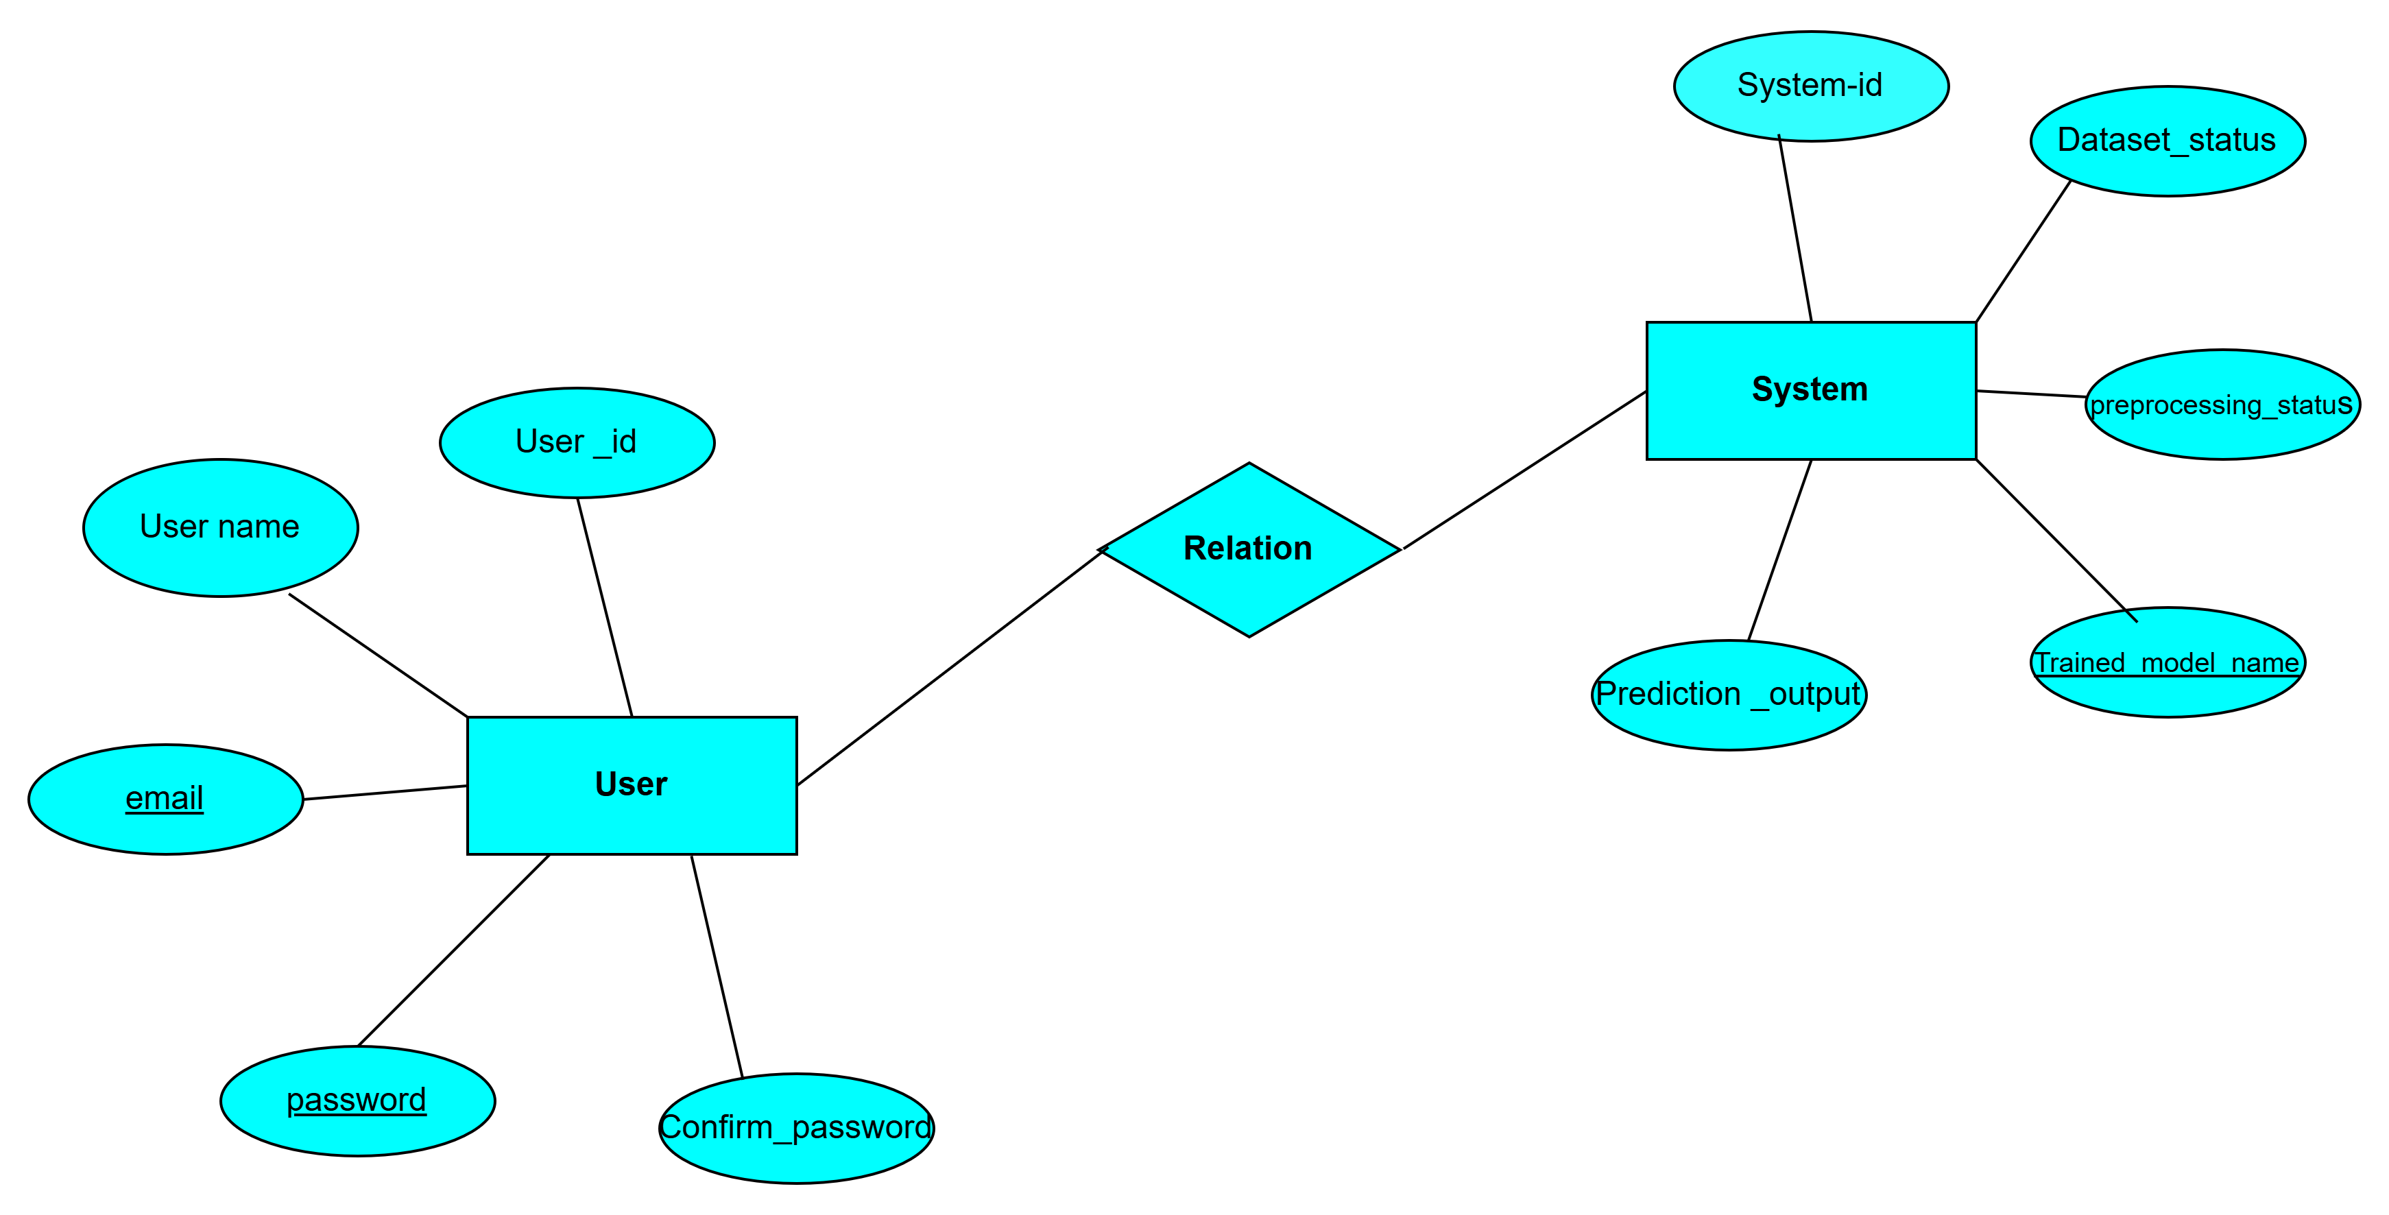
ER DIAGRAM
.

Slide 17
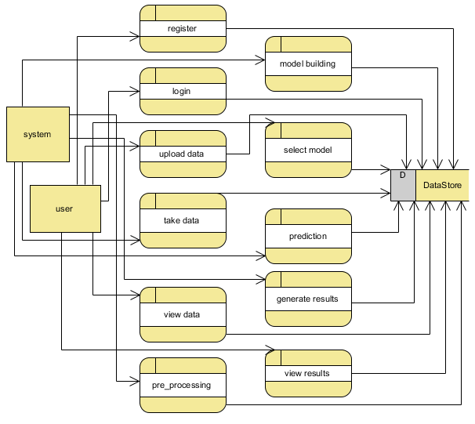
DATA FLOW DIAGRAM
Fig : level 0

Slide 18
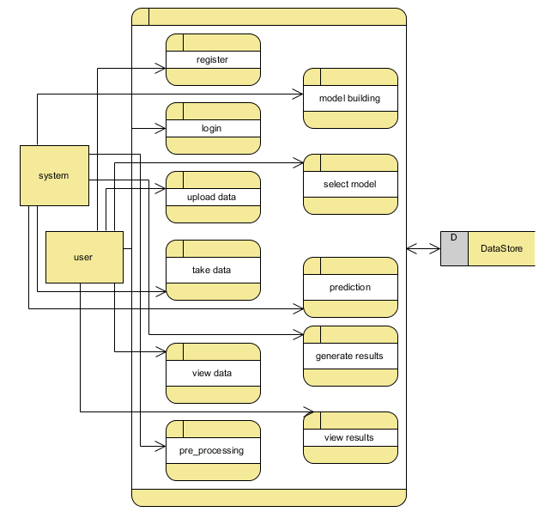
DATA FLOW DIAGRAM
Fig:level 1

Slide 19
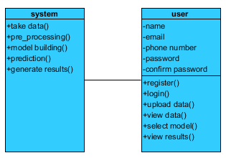
CLASS DIAGRAM

Slide 20
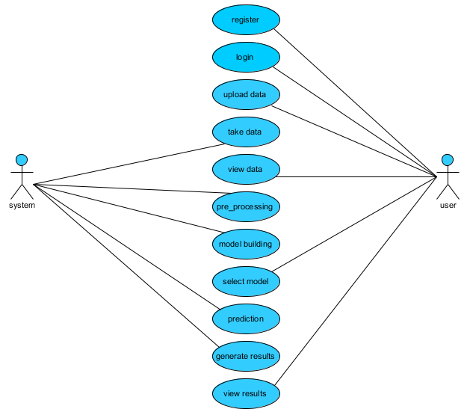
USECASE DIAGRAM

Slide 21
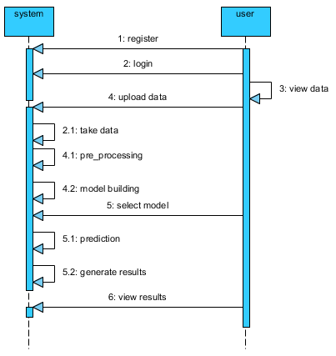
SEQUENCE DIAGRAM

Slide 22
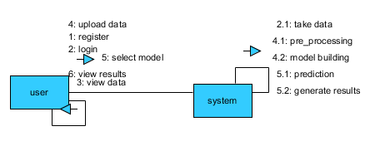
COLLABORATION DIAGRAM

Slide 23
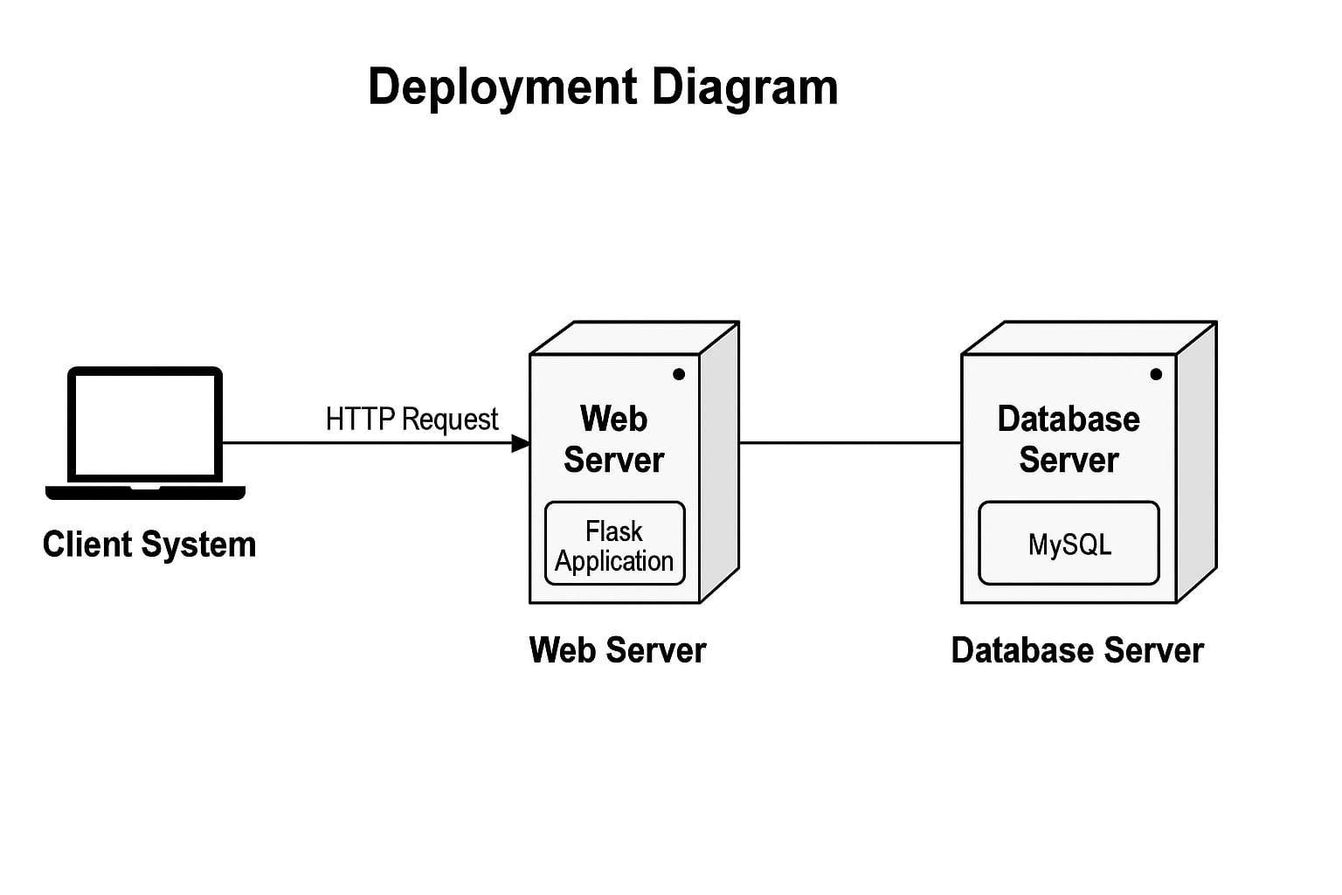
DEPLOYMENT DIAGRAM

Slide 24
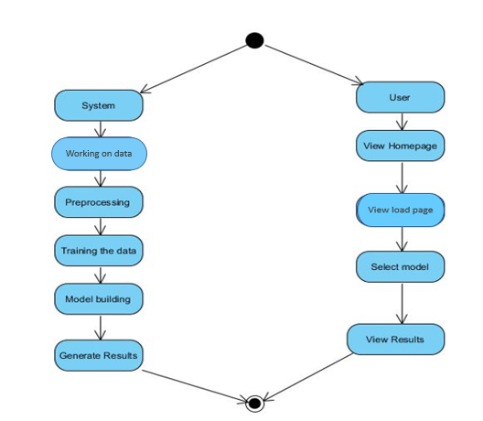
ACTIVITY DIAGRAM:

Slide 25
SYSTEM TESTING
System Testing:
The purpose of testing is to discover errors. Testing is the process of trying to discover every conceivable fault or weakness in a work product.
Types of Tests:
1.Unit testing
Unit testing involves the design of test cases that validate that the internal program logic is functioning properly, and that program inputs produce valid outputs. All decision branches and internal code flow should be validated.

Slide 26
SYSTEM TESTING
2.Integration testing
Integration tests are designed to test integrated software components to determine if they actually run as one program. Testing is event driven and is more concerned with the basic outcome of screens or fields.
Test Results: All the test cases mentioned above passed successfully. No defects encountered.
3.Acceptance Testing
User Acceptance Testing is a critical phase of any project and requires significant participation by the end user. It also ensures that the system meets the functional requirements.
Test Results: All the test cases mentioned above passed successfully. No defects encountered.

Slide 27
SYSTEM TESTING
White Box Testing
White Box Testing is a testing in which in which the software tester has knowledge of the inner workings, structure and language of the software, or at least its purpose. It is purpose. It is used to test areas that cannot be reached from a black box level.
Black Box Testing
Black Box Testing is testing the software without any knowledge of the inner workings, structure or language of the module being tested. It is a testing in which the software under test is treated, as a black box. you cannot “see” into it.

Slide 28
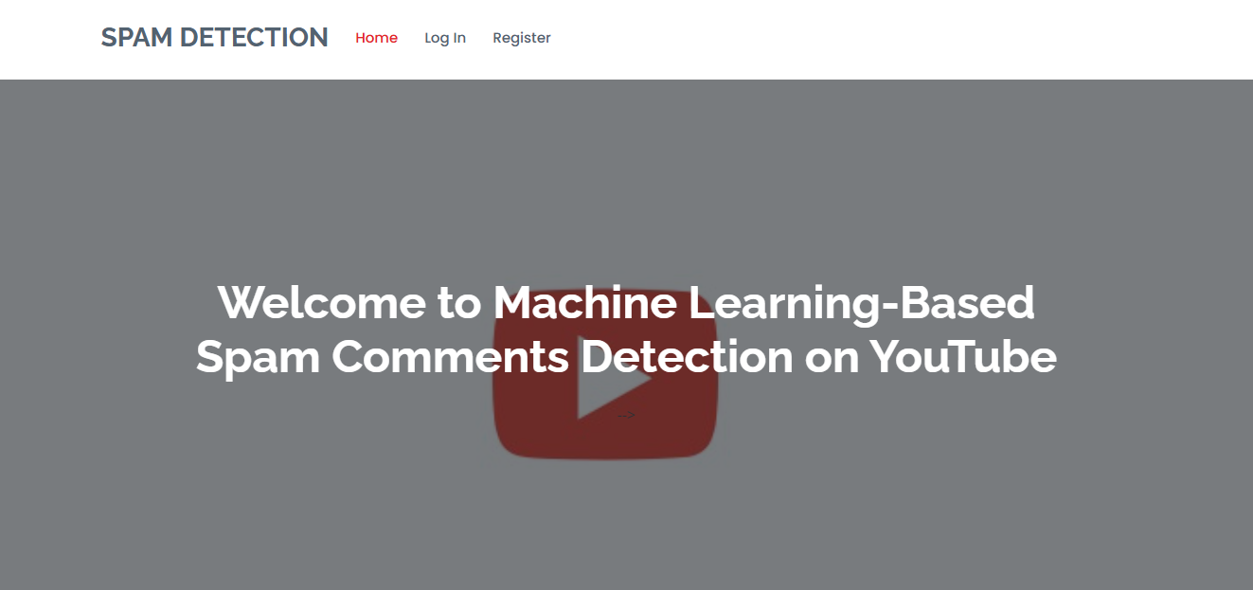
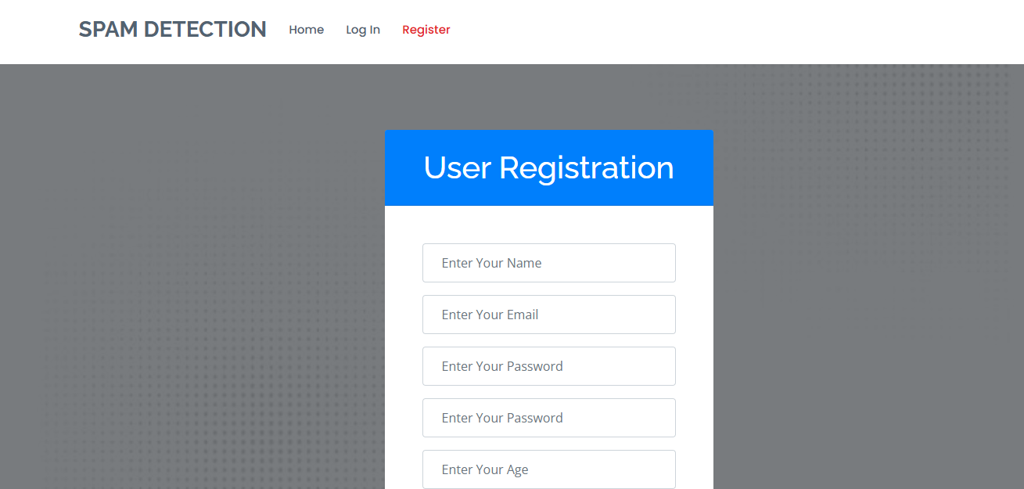
SCREEN SHOTS
Fig:1 Home page: This is You tube Spam Detection home page.
Fig:2 Register Page: User need register with his/her credentials.

Slide 29
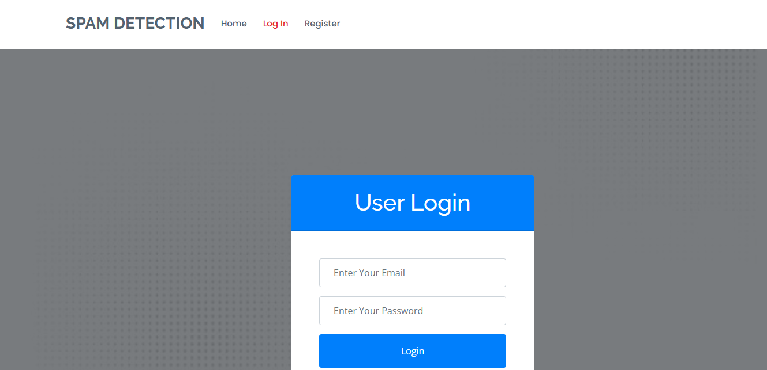
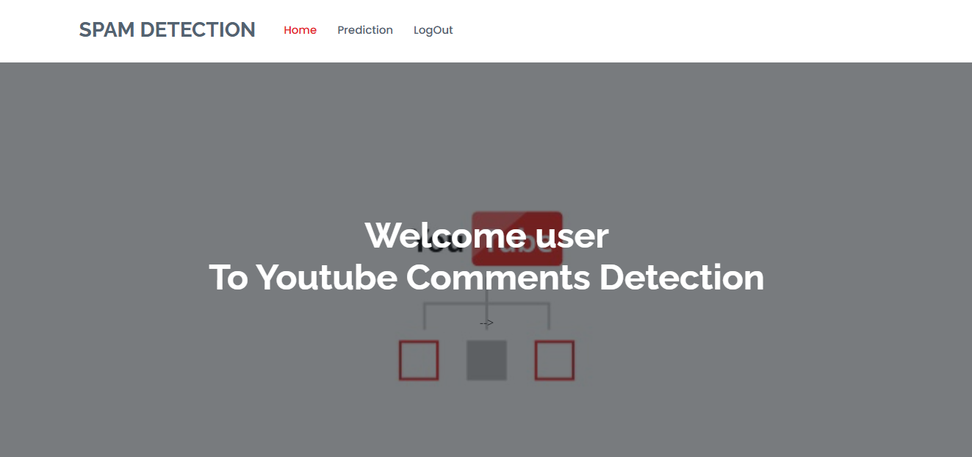
SCREEN SHOTS
Fig:3 Login page: Here the user will login with his credentials.
Fig:4 User home page: After the user login this home page will display.

Slide 30
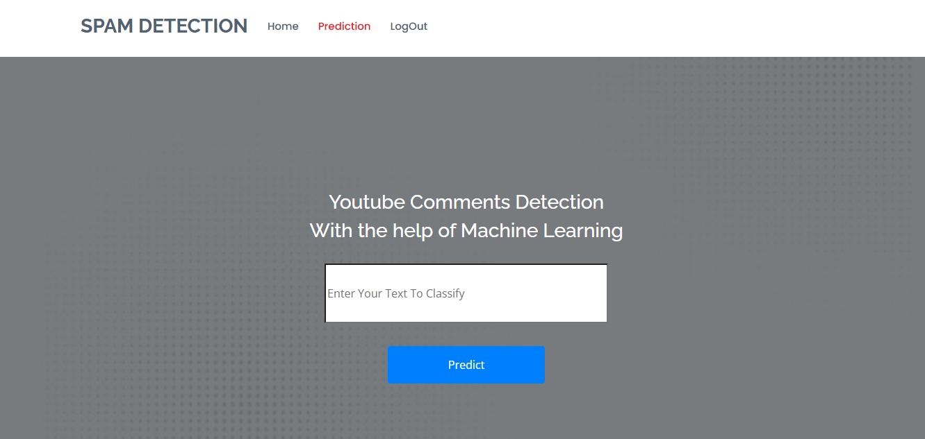
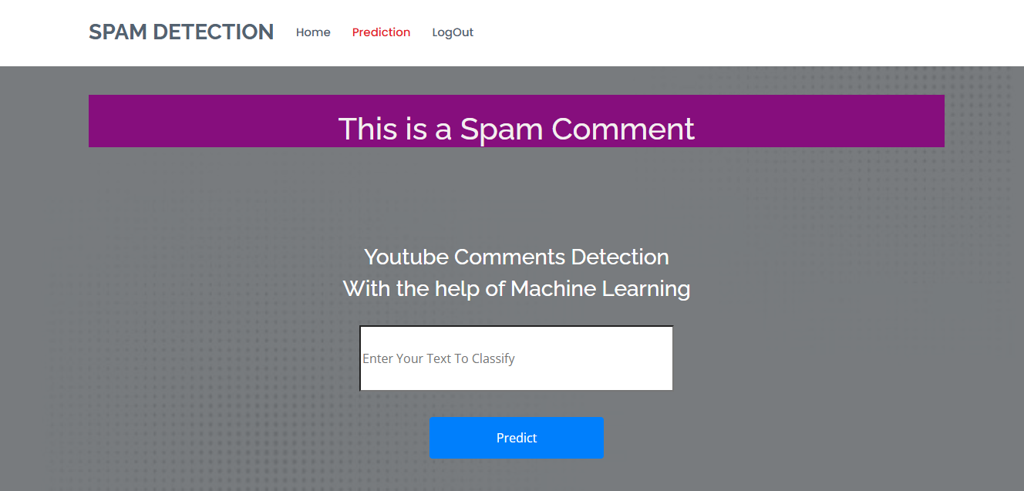
SCREEN SHOTS
Fig:5 User need to enter input based on selecting model, it will predict whether it spam or
not.
Fig:6 Result page: In this page result will display.
Prediction: Spam Content

Slide 31
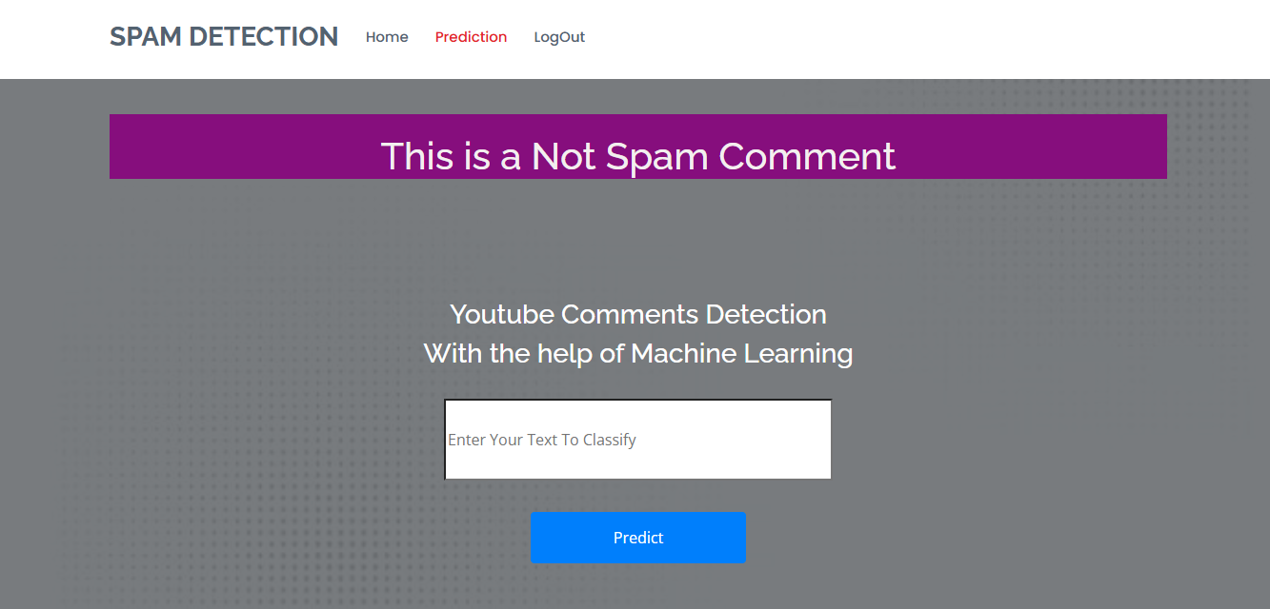
SCREEN SHOTS
Fig:7 Prediction: No Spam Content

Slide 32

CONCLUSION
In conclusion, the YouTube Spam Comment Identification system effectively addresses the challenge of detecting and filtering out harmful spam content.
The proposed classifiers, including naive bayes, Decision tree, MLP classifier, Adaboost, show promise in improving accuracy and efficiency over traditional models.
With further optimization and real-time implementation, the system can be a valuable tool for ensuring a safer, more engaging online environment.

Slide 33
REFERENCES
Yadav, S., & others. (2025). Spam Detection in YouTube Comments: A Machine Learning Approach. ResearchGate.
Xiao, A. S., & others. (2024). Spam Detection for YouTube Video Comments Using Machine Learning Approaches. ResearchGate.
Feng, W., & others. (2016). A Support Vector Machine Based Naive Bayes Algorithm for Spam Filtering. ResearchGate.
Singh, S. (2018). SMS Spam Detection Using Different ML Models: Multinomial Naive Bayes, Support Vector Machine, K-Nearest Neighbors, Random Forest, and AdaBoost. GitHub.
Jain, A. (2020). Build SMS Spam Classification Model Using Naive Bayes & Random Forest. Towards Data Science.

Slide 34
REFERENCES
Kumar, V., & others. (2024). Spam Detection on YouTube Comments Using Advanced Machine Learning Models: A Comparative Study. ResearchGate.
Bassiouni, M., & others. (2022). Deep Convolutional Forest: A Dynamic Deep Ensemble Approach for Spam Detection in Text. Complex & Intelligent Systems.
Sultana, A., & others. (2023). Fake News Detection Using Machine Learning Techniques. ResearchGate.
Albraikan, A., & others. (2023). A Knowledge-Aware NLP-Driven Conversational Model to Detect Deceptive Contents on Social Media Posts. ScienceDirect.
Zhang, L., & others. (2022). A Survey on Text Classification: From Traditional to Deep Learning. ACM Transactions on Intelligent Systems and Technology.

Slide 35
MCA IV Semester Project I Review Presentation
Thank You!
Presented by :P.V.Dharani

